Slide 1
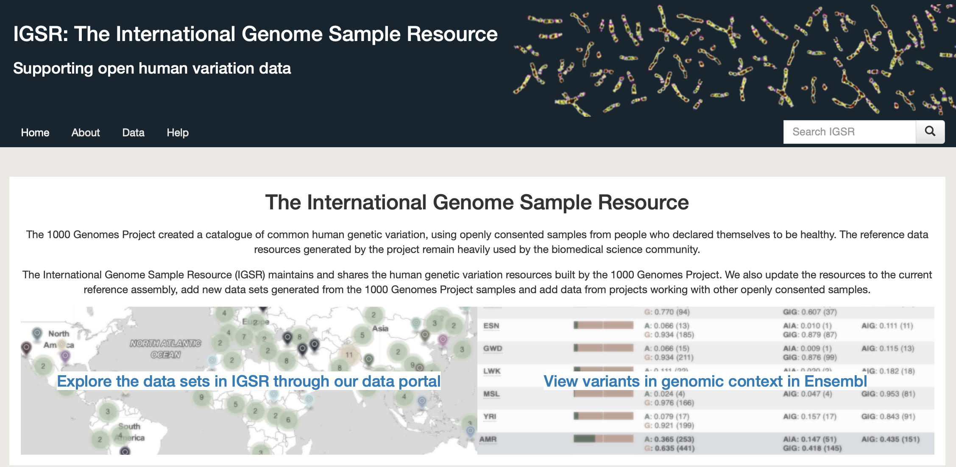
https://www.internationalgenome.org

Slide 2
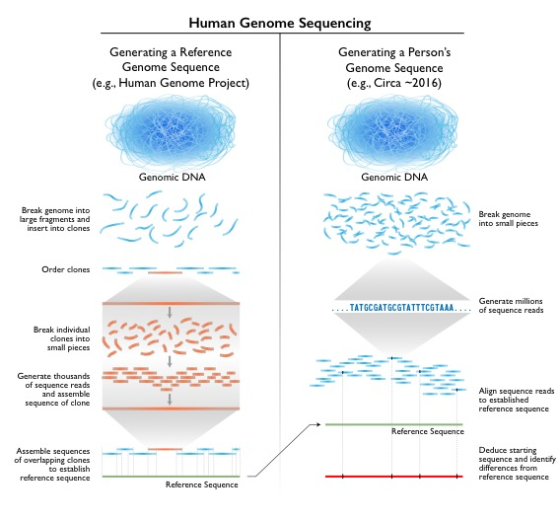
Notes:
Organisms generally differ in their genome sizes. For example, the genome of E. coli (a bacterium that lives in your gut) is ~5 million bases (also called megabases), that of a fruit fly is ~123 million bases, and that of a human is ~3,000 million bases (or ~3 billion bases). There are also some surprising extremes, such as with the loblolly pine tree - its genome is ~23 billion bases in size, over seven times larger than ours.
the quality of the 'finished' HGP sequence was very high, with an estimated error rate of <1 in 100,000 bases; note this is much higher than a typical human genome sequence produced today.
The HGP involved first mapping and then sequencing the human genome. The former was required at the time because there was otherwise no 'framework' for organizing the actual sequencing or the resulting sequence data.

Slide 3
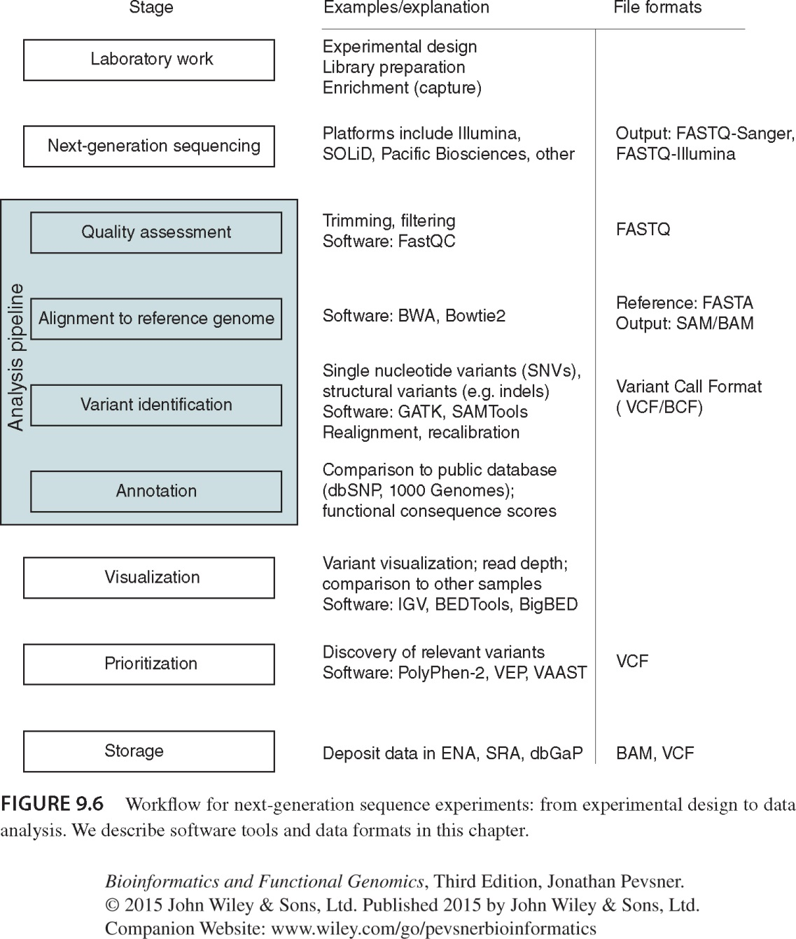

Slide 4
Identifying Putatively Deleterious Variants Using Next-generation Sequencing
Genotyping
Samtools: mpileup
Fastq Files
Alignment & sorting
BWA aln algorithm
Annotation
ANNOVAR

Slide 5
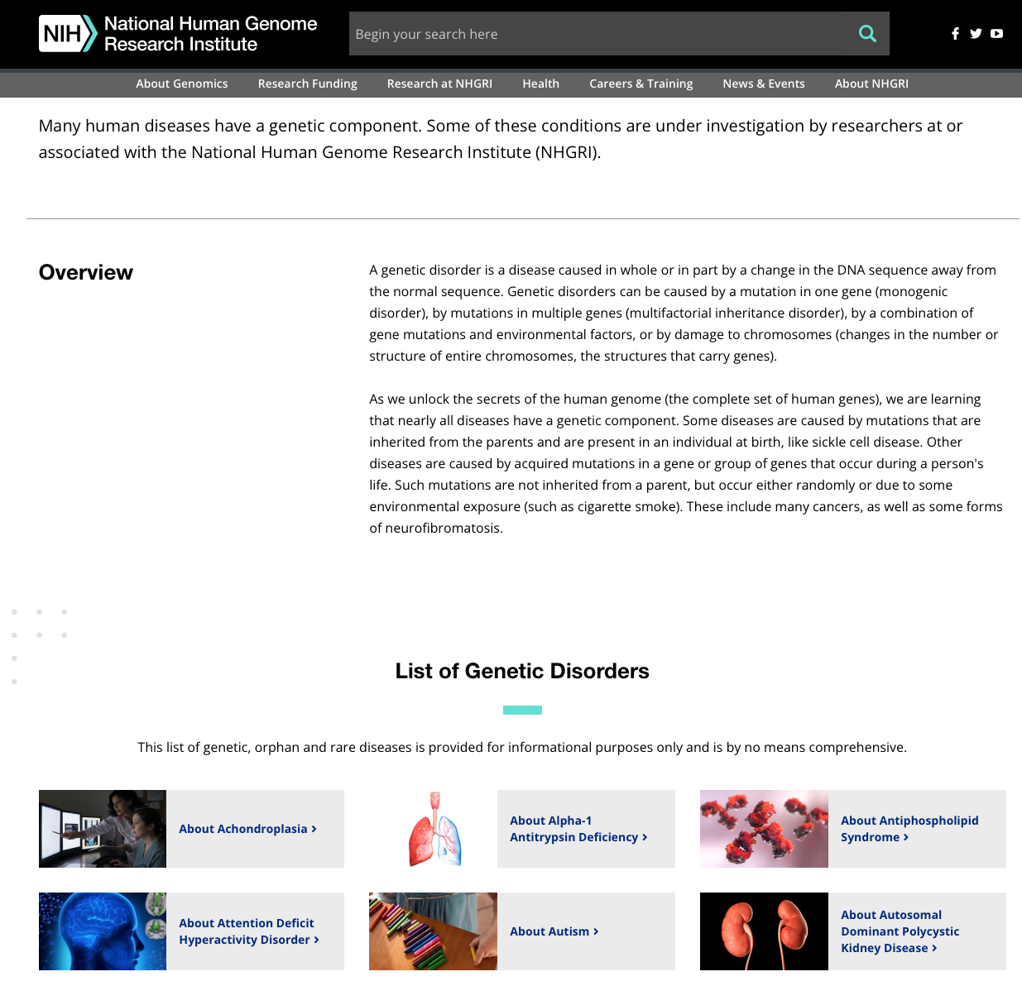
Human genetic diseases
https://www.genome.gov/For-Patients-and-Families/Genetic-Disorders

Slide 6
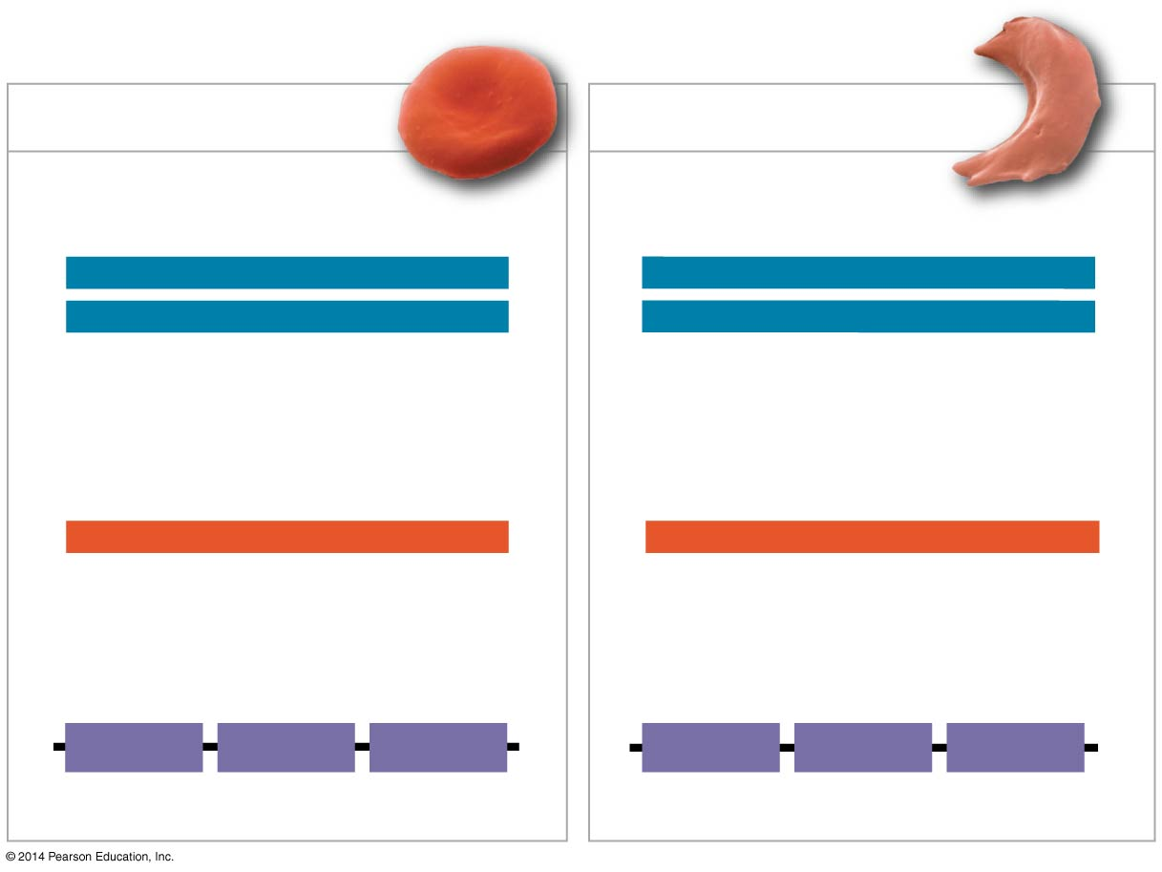
Wild-type β-globin
Sickle-cell β-globin
Wild-type β-globin DNA
Mutant β-globin DNA
3′
C
T
C
5′
3′
C
A
C
5′
5′
G
A
G
3′
5′
G
T
G
3′
mRNA
mRNA
5′
G
A
G
3′
5′
G
U
G
3′
Normal hemoglobin
Sickle-cell hemoglobin
Glu
Val
Notes:
Figure 17.25 The molecular basis of sickle-cell disease: a point mutation

Slide 7
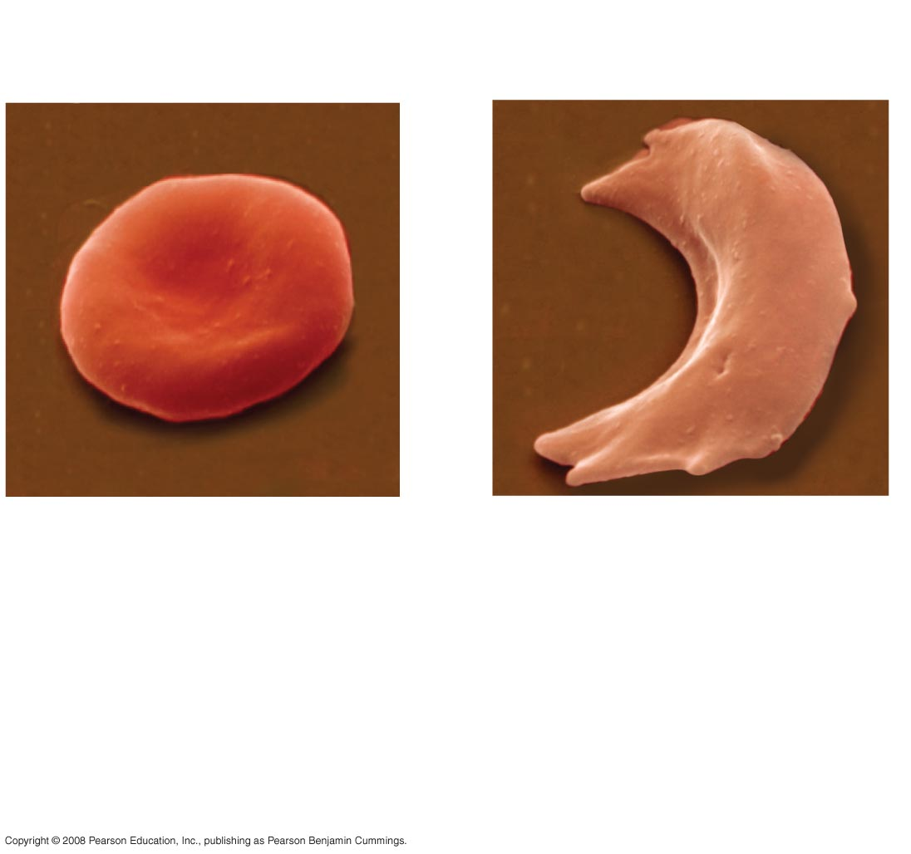
10 µm
10 µm
Normal red blood
cells are full of
Individual hemoglobin
molecules, each
carrying oxygen.
Fibers of abnormal
hemoglobin deform
red blood cell into
sickle shape.
Notes:
Figure 5.22 A single amino acid substitution in a protein causes sickle-cell disease

Slide 8
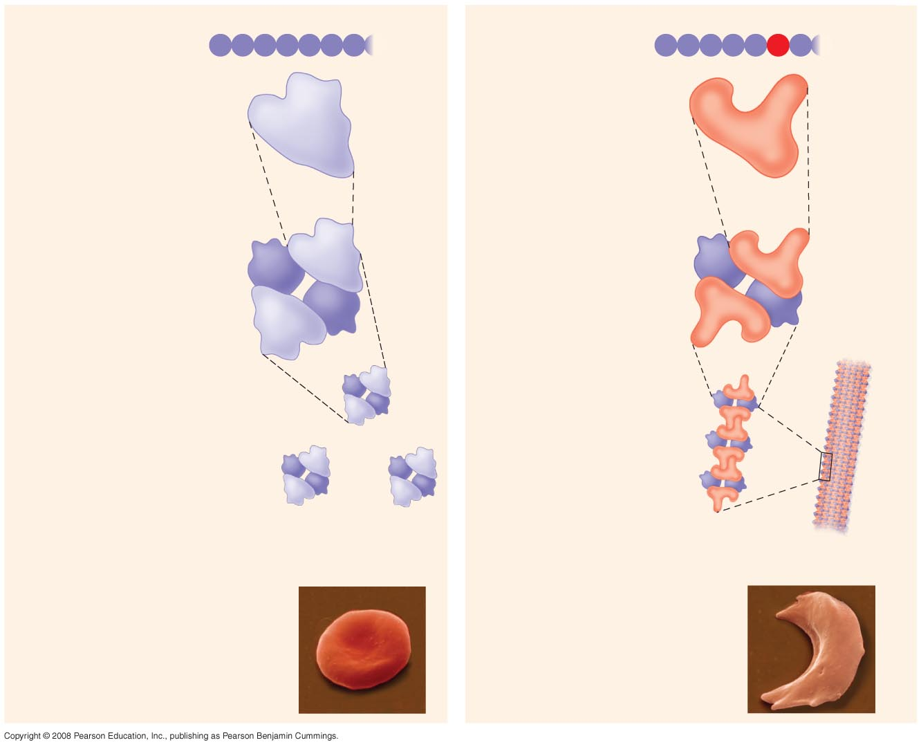
Normal hemoglobin
Primary
structure
Sickle-cell hemoglobin
Primary
structure
Val
His
Leu
Thr
Pro
Glu
Glu
Val
His
Leu
Thr
Pro
Val
Glu
1
2
3
4
5
6
7
1
2
3
4
5
6
7
Secondary
and tertiary
structures
Secondary
and tertiary
structures
Exposed
hydrophobic
region
β subunit
β subunit
α
β
α
Quaternary
structure
Normal
hemoglobin
(top view)
Quaternary
structure
Sickle-cell
hemoglobin
β
β
α
β
α
Function
Molecules do
not associate
with one
another; each
carries oxygen.
Function
Molecules
interact with
one another and
crystallize into
a fiber; capacity
to carry oxygen
is greatly reduced.
10 µm
10 µm
Red blood
cell shape
Normal red blood
cells are full of
individual
hemoglobin
moledules, each
carrying oxygen.
Red blood
cell shape
Fibers of abnormal
hemoglobin deform
red blood cell into
sickle shape.
Notes:
Figure 5.22 A single amino acid substitution in a protein causes sickle-cell disease

Slide 9
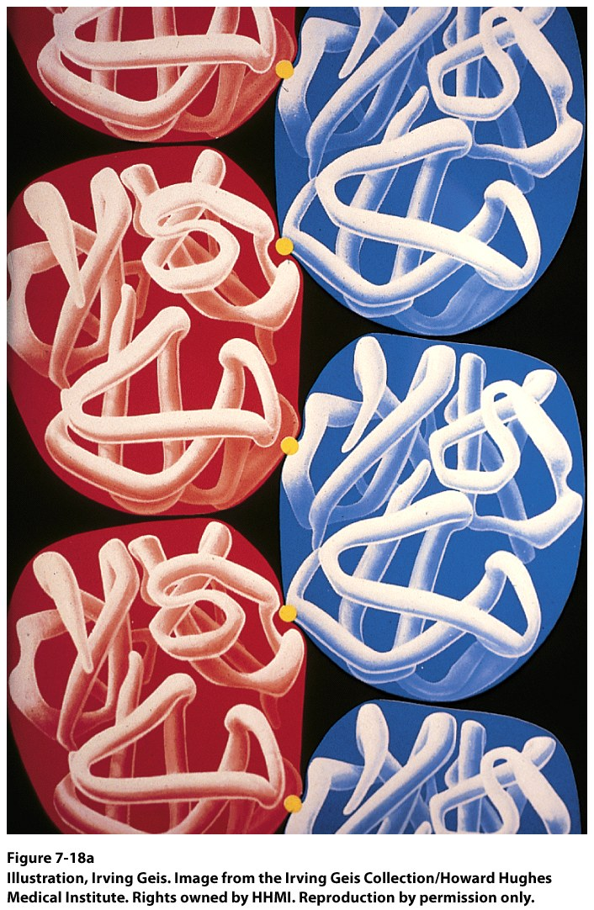
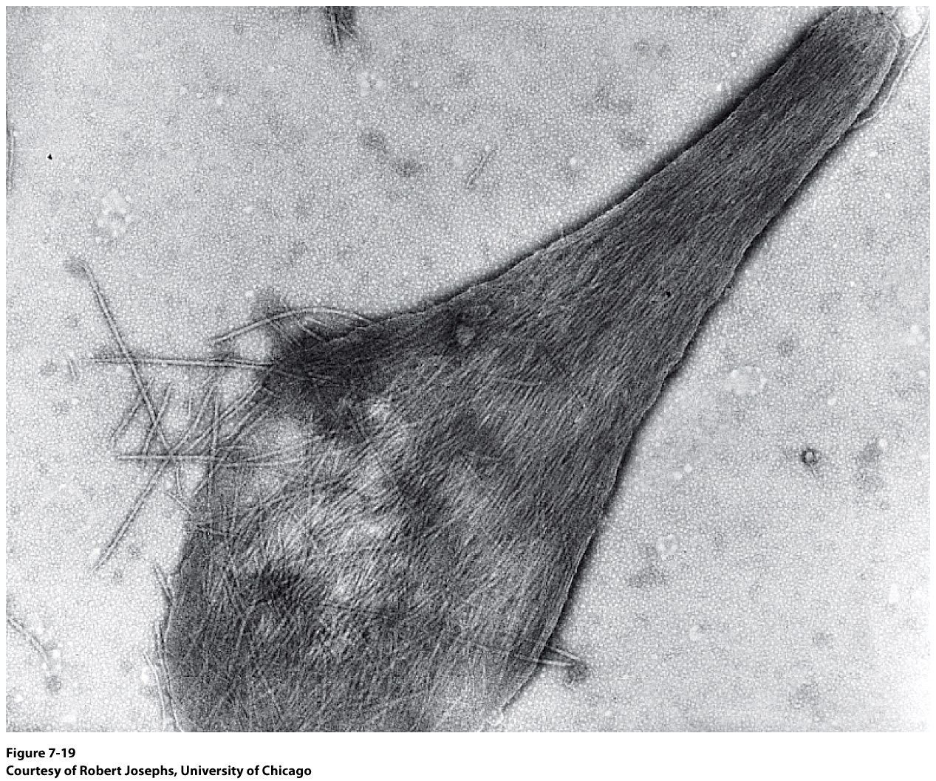
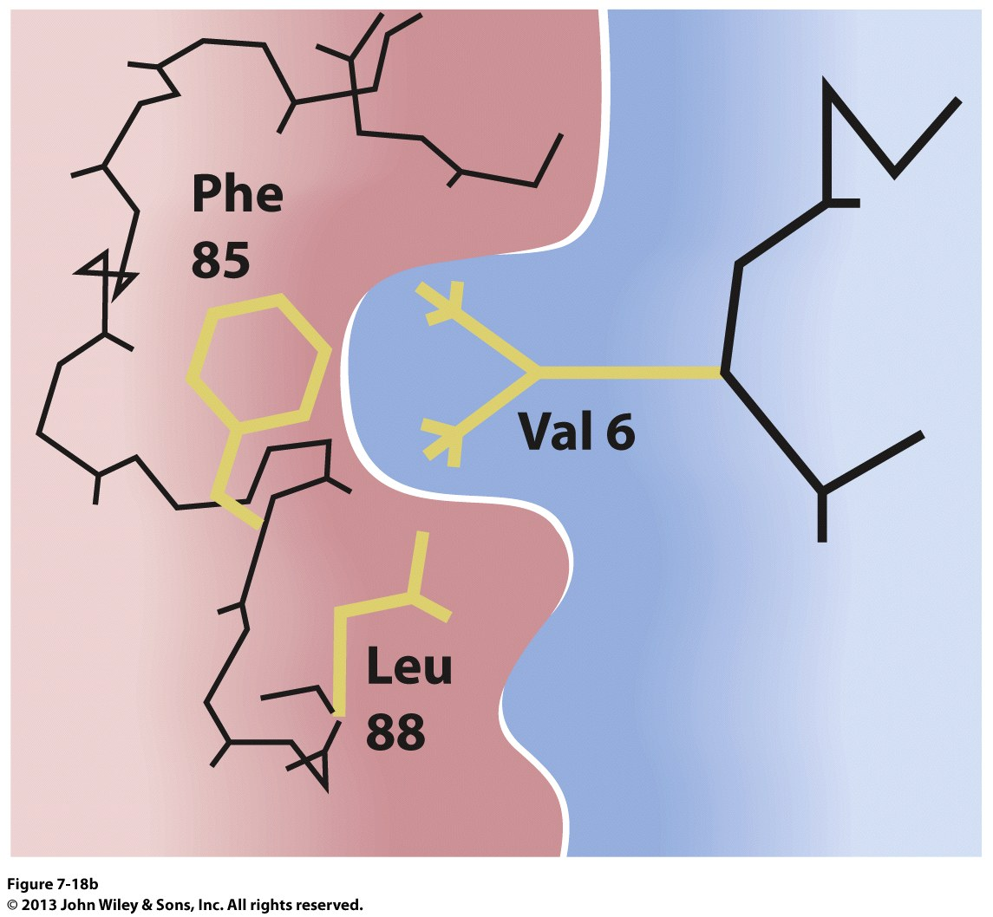
Deoxyhemoglobin S Fibers
Notes:
Deoxyhemoglobin S: Mutant Val6 Interacts with Phe85

Slide 10
Types of Small-Scale Mutations
Point mutations within a gene can be divided into two general categories:
Nucleotide-pair substitutions
One or more nucleotide-pair insertions or deletions

Slide 11
Substitutions
A nucleotide-pair substitution replaces one nucleotide and its partner with another pair of nucleotides
Silent (synonymous) mutations have no effect on the amino acid produced by a codon because of redundancy in the genetic code
Missense (non-synonymous) mutations still code for an amino acid, but not the correct amino acid
Nonsense mutations change an amino acid codon into a stop codon, nearly always leading to a nonfunctional protein

Slide 12
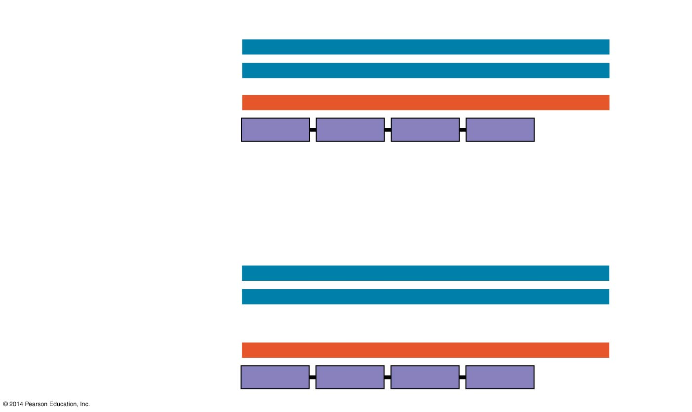
Wild type
DNA template strand
3′
T
A
C
T
T
C
A
A
A
C
C
G
A
T
T
5′
5′
A
T
G
A
A
G
T
T
T
G
G
C
T
A
A
3′
mRNA
Protein
5′
A
U
G
A
A
G
U
U
U
G
G
C
U
A
A
3′
Met
Lys
Phe
Gly
Stop
Amino end
Carboxyl end
Nucleotide-pair substitution: silent
A instead of G
3′
T
A
C
T
T
C
A
A
A
C
C
A
A
T
T
5′
5′
A
T
G
A
A
G
T
T
T
G
G
T
T
A
A
3′
U instead of C
5′
A
U
G
A
A
G
U
U
U
G
G
U
U
A
A
3′
Met
Lys
Phe
Gly
Stop
Notes:
Figure 17.26a Types of small-scale mutations that affect mRNA sequence (part 1: silent)
Synanonmus mutatins may alter protein function because they result in an altred conformation of the protein. Because the protein folding is a co-translational process and protein folding is slightly linked to the speed of translation.

Slide 13
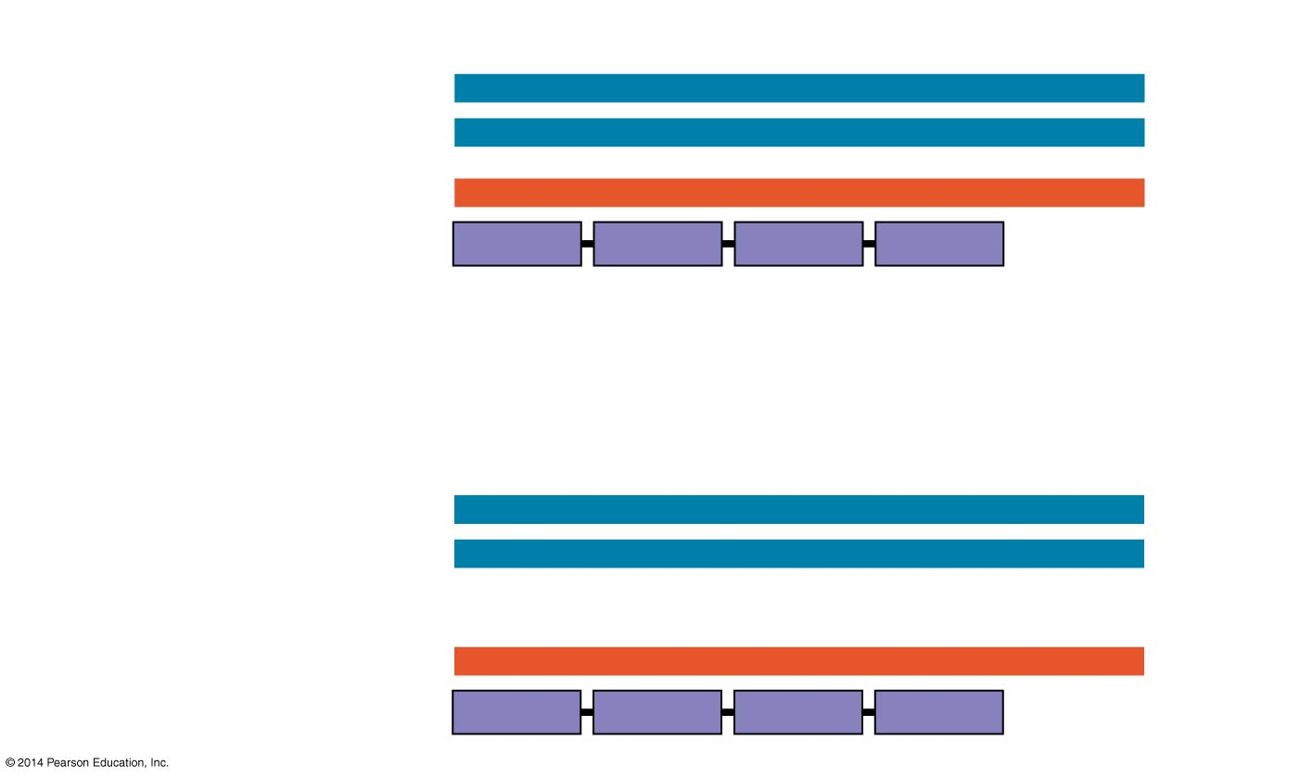
Wild type
DNA template strand
3′
T
A
C
T
T
C
A
A
A
C
C
G
A
T
T
5′
5′
A
T
G
A
A
G
T
T
T
G
G
C
T
A
A
3′
mRNA
Protein
5′
A
U
G
A
A
G
U
U
U
G
G
C
U
A
A
3′
Met
Lys
Phe
Gly
Stop
Amino end
Carboxyl end
Nucleotide-pair substitution: missense
T instead of C
3′
T
A
C
T
T
C
A
A
A
T
C
G
A
T
T
5′
5′
A
T
G
A
A
G
T
T
T
A
G
C
T
A
A
3′
A instead of G
5′
A
U
G
A
A
G
U
U
U
A
G
C
U
A
A
3′
Met
Lys
Phe
Ser
Stop
Notes:
Figure 17.26b Types of small-scale mutations that affect mRNA sequence (part 2: missense)

Slide 14
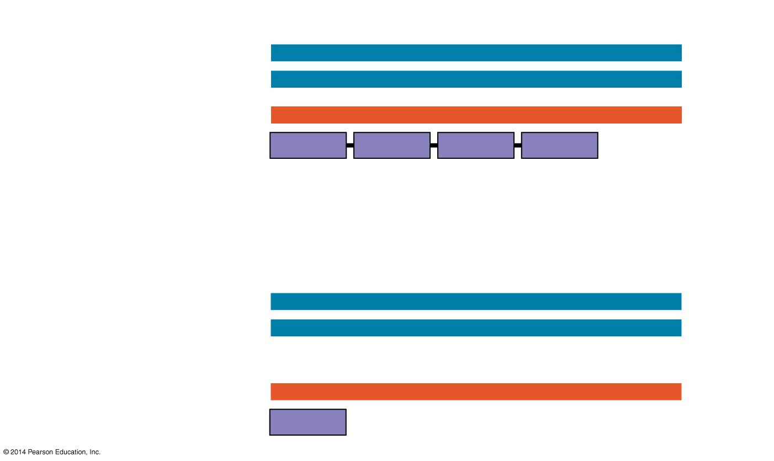
Wild type
DNA template strand
3′
T
A
C
T
T
C
A
A
A
C
C
G
A
T
T
5′
5′
A
T
G
A
A
G
T
T
T
G
G
C
T
A
A
3′
mRNA
Protein
5′
A
U
G
A
A
G
U
U
U
G
G
C
U
A
A
3′
Met
Lys
Phe
Gly
Stop
Amino end
Carboxyl end
Nucleotide-pair substitution: nonsense
A instead of T
3′
T
A
C
A
T
C
A
A
A
C
C
G
A
T
T
5′
5′
A
T
G
T
A
G
T
T
T
G
G
C
T
A
A
3′
U instead of A
5′
A
U
G
U
A
G
U
U
U
G
G
U
U
A
A
3′
Met
Stop
Notes:
Figure 17.26c Types of small-scale mutations that affect mRNA sequence (part 3: nonsense)

Slide 15
Insertions and Deletions
Insertions and deletions are additions or losses of nucleotide pairs in a gene
These mutations have a disastrous effect on the resulting protein more often than substitutions do
Insertion or deletion of nucleotides may alter the reading frame, producing a frameshift mutation

Slide 16
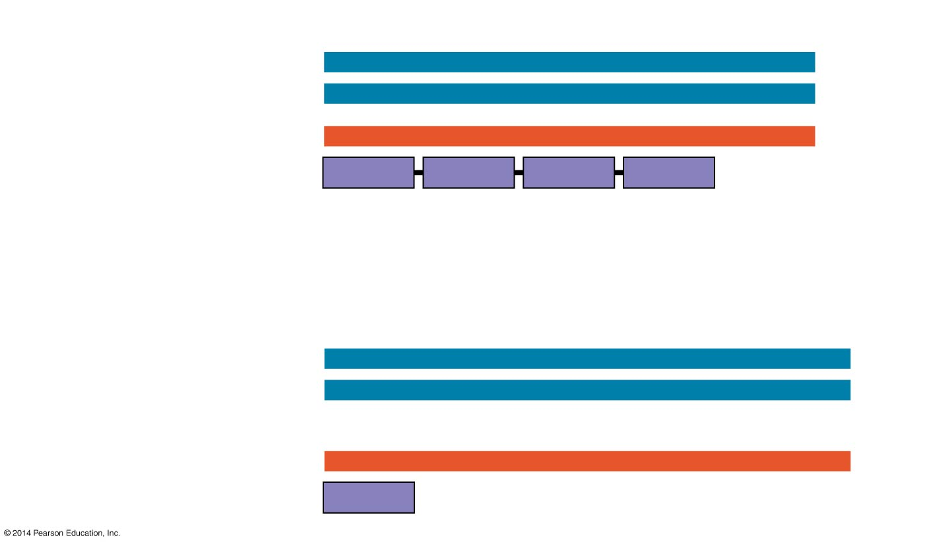
Wild type
DNA template strand
3′
T
A
C
T
T
C
A
A
A
C
C
G
A
T
T
5′
5′
A
T
G
A
A
G
T
T
T
G
G
C
T
A
A
3′
mRNA
Protein
5′
A
U
G
A
A
G
U
U
U
G
G
C
U
A
A
3′
Met
Lys
Phe
Gly
Stop
Amino end
Carboxyl end
Nucleotide-pair insertion: frameshift causing immediate nonsense
Extra A
3′
T
A
C
A
T
T
C
A
A
A
C
C
G
A
T
T
5′
5′
A
T
G
T
A
A
G
T
T
T
G
G
C
T
A
A
3′
5′
A
U
G
U
A
A
G
U
U
U
G
G
C
U
A
A
3′
Met
Stop
Notes:
Figure 17.26d Types of small-scale mutations that affect mRNA sequence (part 4: frameshift, nonsense)

Slide 17
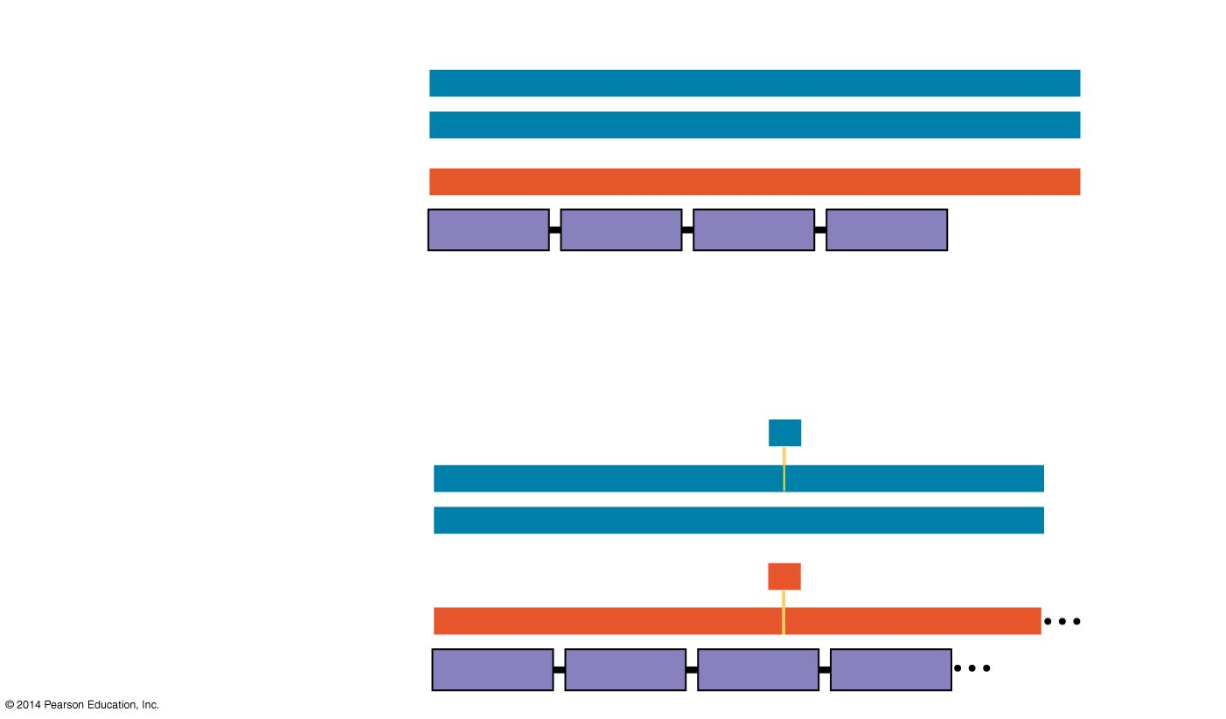
Wild type
DNA template strand
3′
T
A
C
T
T
C
A
A
A
C
C
G
A
T
T
5′
5′
A
T
G
A
A
G
T
T
T
G
G
C
T
A
A
3′
mRNA
Protein
5′
A
U
G
A
A
G
U
U
U
G
G
C
U
A
A
3′
Met
Lys
Phe
Gly
Stop
Amino end
Carboxyl end
Nucleotide-pair deletion: frameshift causing extensive missense
A
missing
3′
T
A
C
T
T
C
A
A
C
C
G
A
T
T
5′
5′
A
T
G
A
A
G
T
T
G
G
C
T
A
A
3′
U
missing
5′
A
U
G
A
A
G
U
U
G
G
C
U
A
A
3′
Met
Lys
Leu
Ala
Notes:
Figure 17.26e Types of small-scale mutations that affect mRNA sequence (part 5: frameshift, missense)

Slide 18
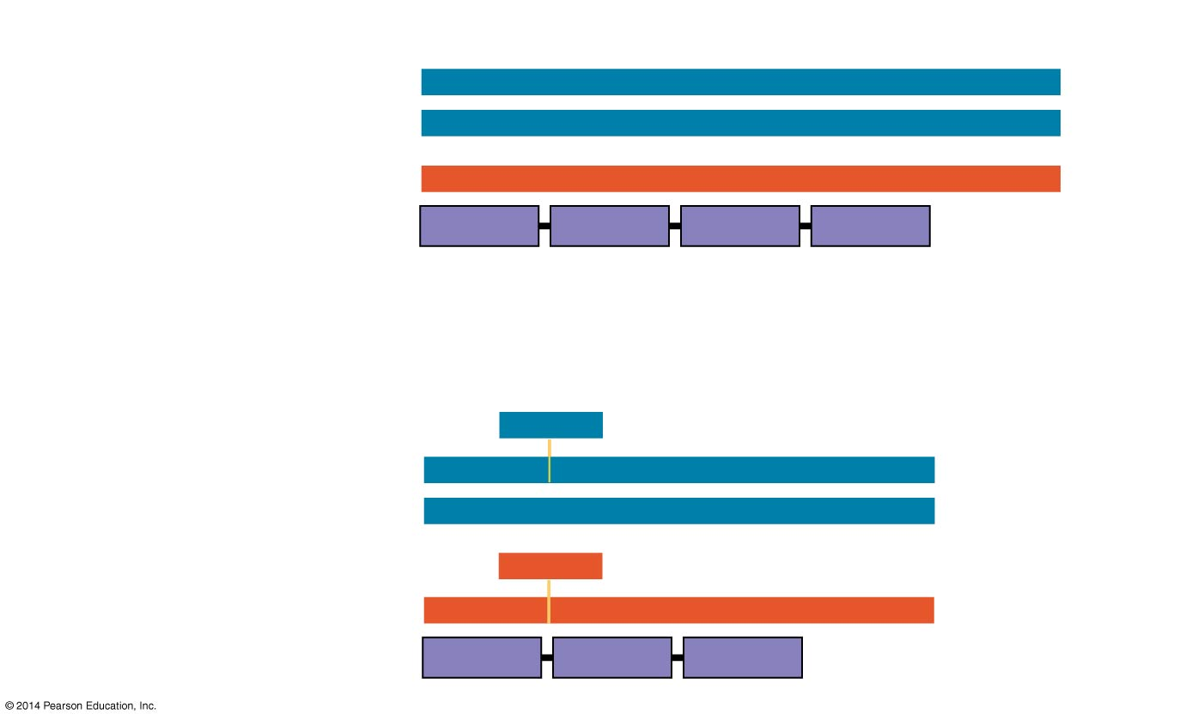
Wild type
DNA template strand
3′
T
A
C
T
T
C
A
A
A
C
C
G
A
T
T
5′
5′
A
T
G
A
A
G
T
T
T
G
G
C
T
A
A
3′
mRNA
Protein
5′
A
U
G
A
A
G
U
U
U
G
G
C
U
A
A
3′
Met
Lys
Phe
Gly
Stop
Amino end
Carboxyl end
3 nucleotide-pair deletion: no frameshift, but one amino acid missing
T
T
C
missing
3′
T
A
C
A
A
A
C
C
G
A
T
T
5′
5′
A
T
G
T
T
T
G
G
C
T
A
A
3′
A
A
G
missing
5′
A
U
G
U
U
U
G
G
C
U
A
A
3′
Met
Phe
Gly
Stop
Notes:
Figure 17.26f Types of small-scale mutations that affect mRNA sequence (part 6: missing amino acid)

Slide 19
In humans, researchers have analyzed the genomes of many people with a certain genetic condition to try to find nucleotide changes specific to the condition
These genome-wide association studies (GWAS) test for genetic markers, sequences that vary among individuals
Variations in coding or noncoding DNA sequences among a population are called polymorphisms
SNPs (single nucleotide polymorphisms), single nucleotide variants, are among the most useful genetic markers
Notes:
These studies do not require complete sequencing of aal of the genomes in the two groups.

Slide 20
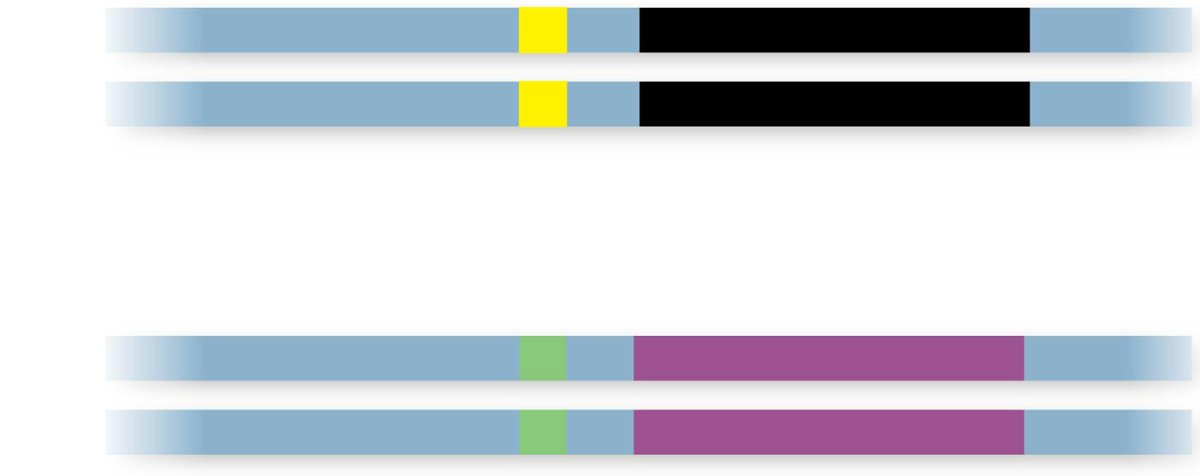
A
DNA
T
Normal allele
SNP
Disease-causing allele
C
G
A single base-pair site where variation is found in at least 1% of the population is called a SNP
SNP variants that are found frequently associated with a particular inherited disorder alert researchers to the most likely location for the disease-causing gene
SNPs are rarely directly involved in the disease; they are most often in noncoding regions of the genome
Notes:
They can be detected by PCR or very sensitive microarrays

Slide 21
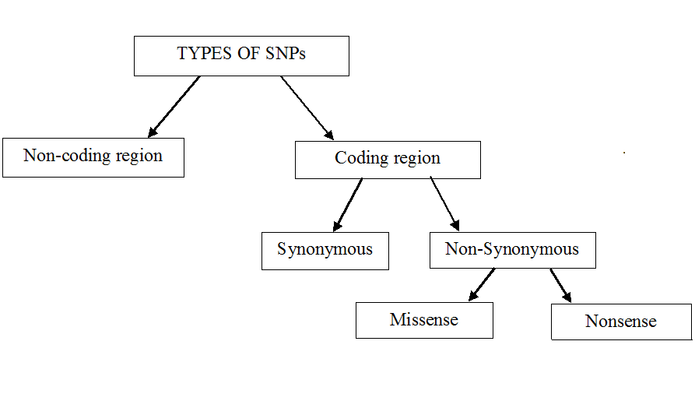
https://en.wikipedia.org/wiki/Single-nucleotide_polymorphism

Slide 22
SNPs and disease
SNPs identified by GWAS may be informative with respect to disease
[1] Functional variation: A SNP associated with a non-synonymous substitution in a coding region will change the amino acid sequence of a protein.
[2] Regulatory variation: A SNP in a noncoding region can influence gene expression.
[3] Association: SNPs can be used in whole-genome association studies. SNP frequency is compared between affected and control populations.
dbSNP at NCBI
http://www.ncbi.nlm.nih.gov/SNP

Slide 23
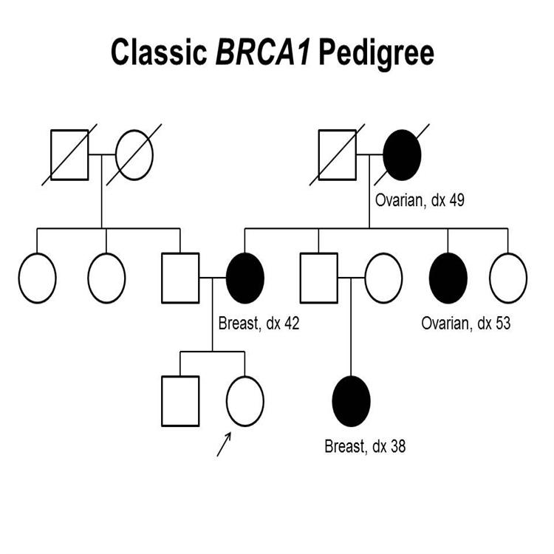
Monogenic (single gene) disorders
Monogenic disorders: segregate within families and have high penetrance
Previously, a large distinction was made between monogenic and polygenic (complex) disorders. They are now seen to be more on a continuum.
For a short review see
https://www.nature.com/scitable/topicpage/rare-genetic-disorders-learning-about-genetic-disease-979/
Notes:
We may define a single-gene disorder as a disorder that is caused primarily by mutation(s) in a single gene. However, as we will see below, all monogenic disorders involve many genes.
Pedigree showing some of the classic features of a family with a deleterious BRCA1 mutation across three generations, including transmission occurring through maternal and paternal lineages. The unaffected female proband is shown as having an affected mother (breast cancer diagnosed at age 42 y), female cousin (breast cancer diagnosed at age 38 y), maternal aunt (ovarian cancer diagnosed at age 53 y), and maternal grandmother (ovarian cancer diagnosed at age 49 y). BRCA1 pedigree. This pedigree shows some of the classic features of a family with a deleterious BRCA1 mutation across three generations, including affected family members with breast cancer or ovarian cancer and a young age at onset. BRCA1 families may exhibit some or all of these features. As an autosomal dominant syndrome, a deleterious BRCA1 mutation can be transmitted through maternal or paternal lineages, as depicted in the figure.
https://visualsonline.cancer.gov/details.cfm?imageid=10436

Slide 24
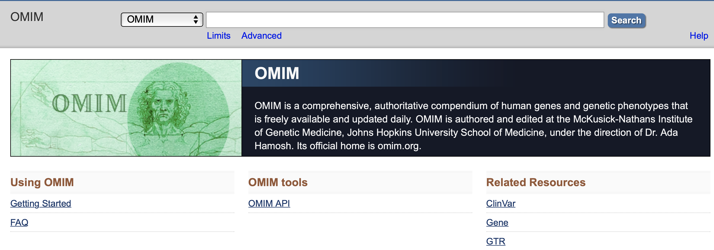
The principal disease database: OMIM
http://www.ncbi.nlm.nih.gov/omim
Online Mendelian Inheritance in Man (OMIM) is a comprehensive database for human genes and genetic disorders, with a focus on monogenic disorders (it focuses on Mendelian disorders).
It contains description of all known genetic disorders with links to repositories containing sequences.
There are almost no entries on chromosomal diseases.
Notes:
OMIM went online at NCBI in 1995

Slide 25
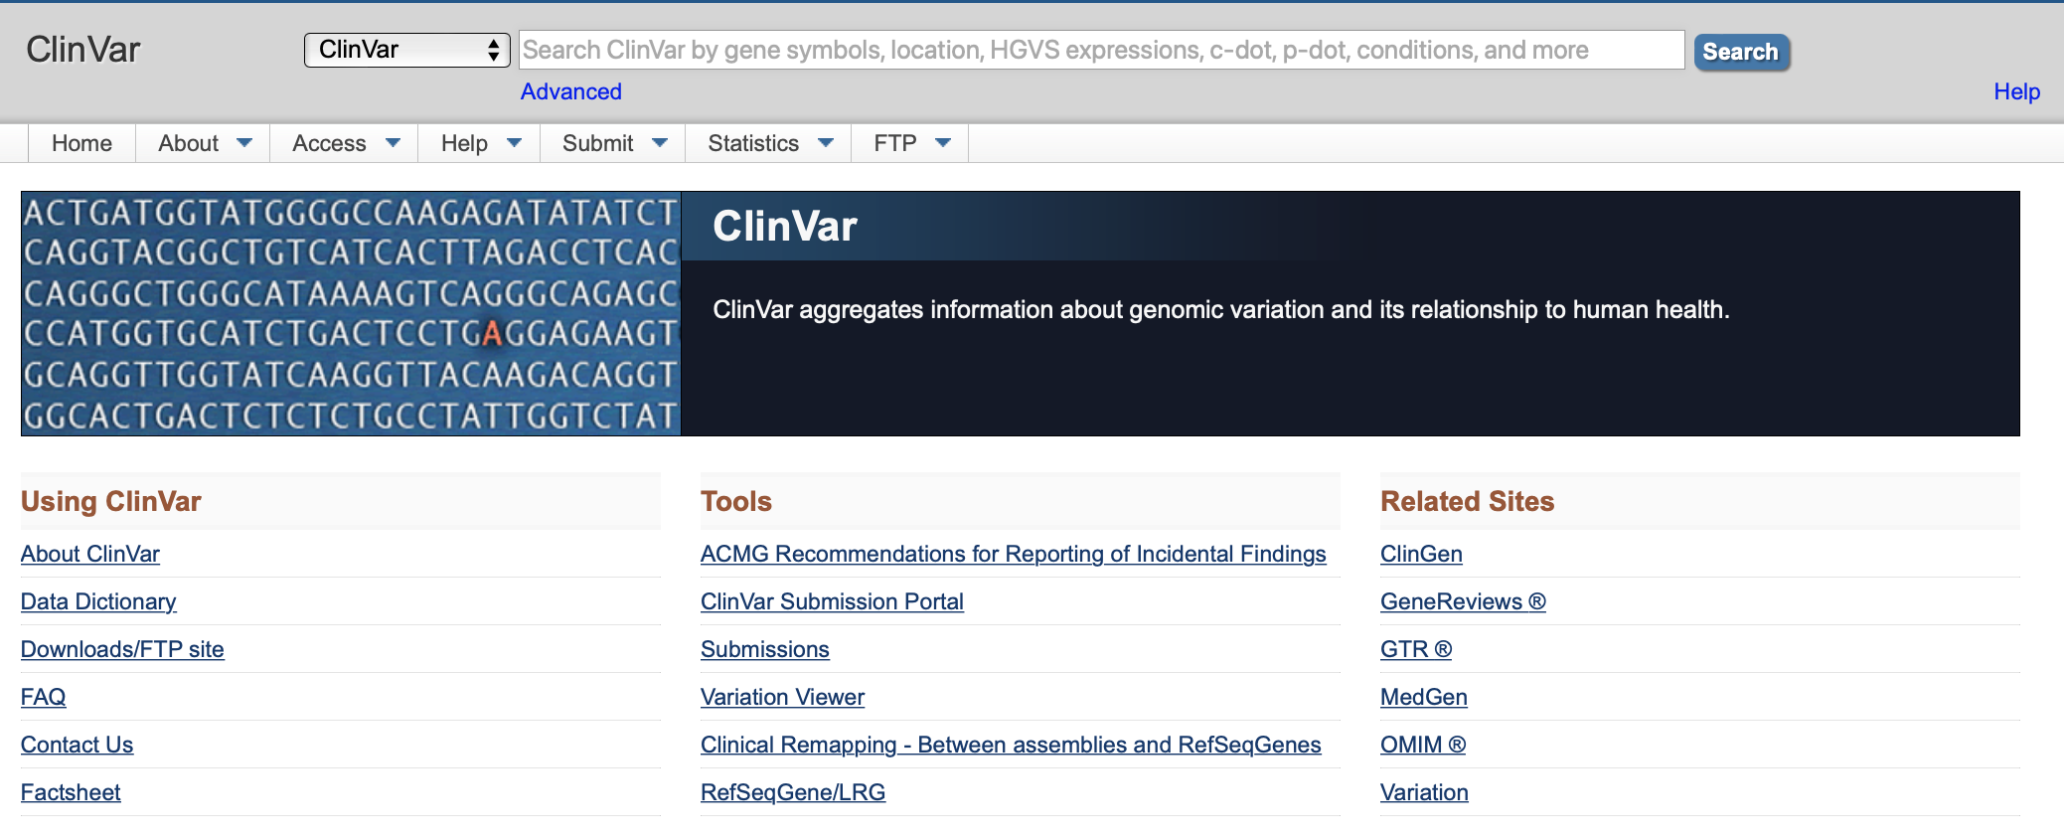
Clinvar: https://www.ncbi.nlm.nih.gov/clinvar
Notes:
Figure 5.14 The 20 amino acids of proteins

Slide 27
Science 355 (6331), 1266-1267
Bad luck' mutations increase cancer risk more than behavior
Overall, 66% of the genetic mutations leading to cancer are due to random errors, study says
environmental factors contribute 29% of mutations, while the remaining 5% are inherited
Notes:
http://www.cnn.com/2017/03/23/health/cancer-mutations-bad-luck-study

Slide 28
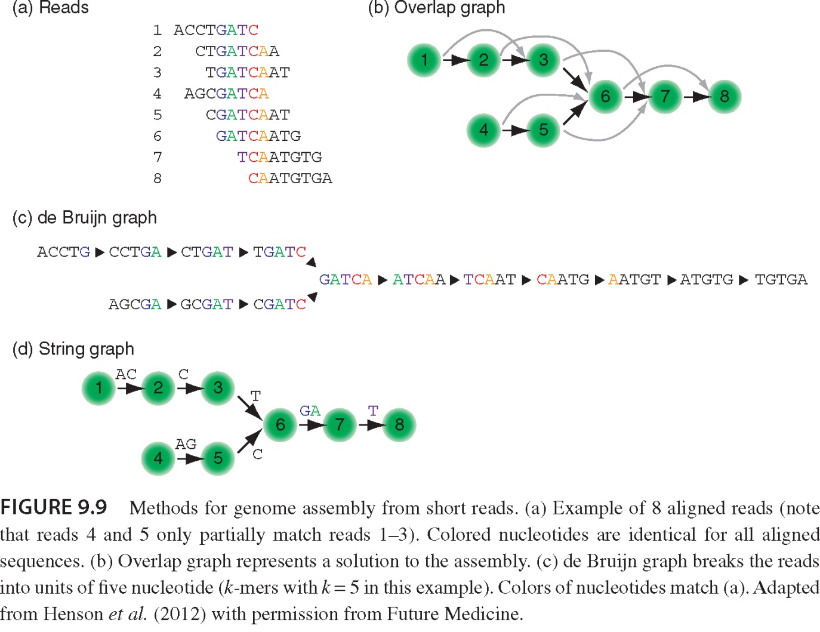

Slide 29
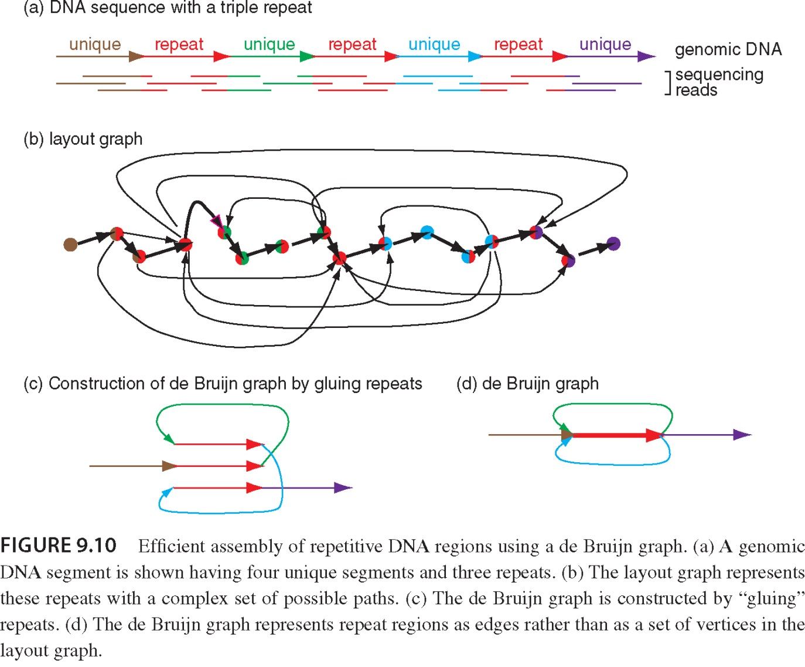

Slide 30
